Slide 1
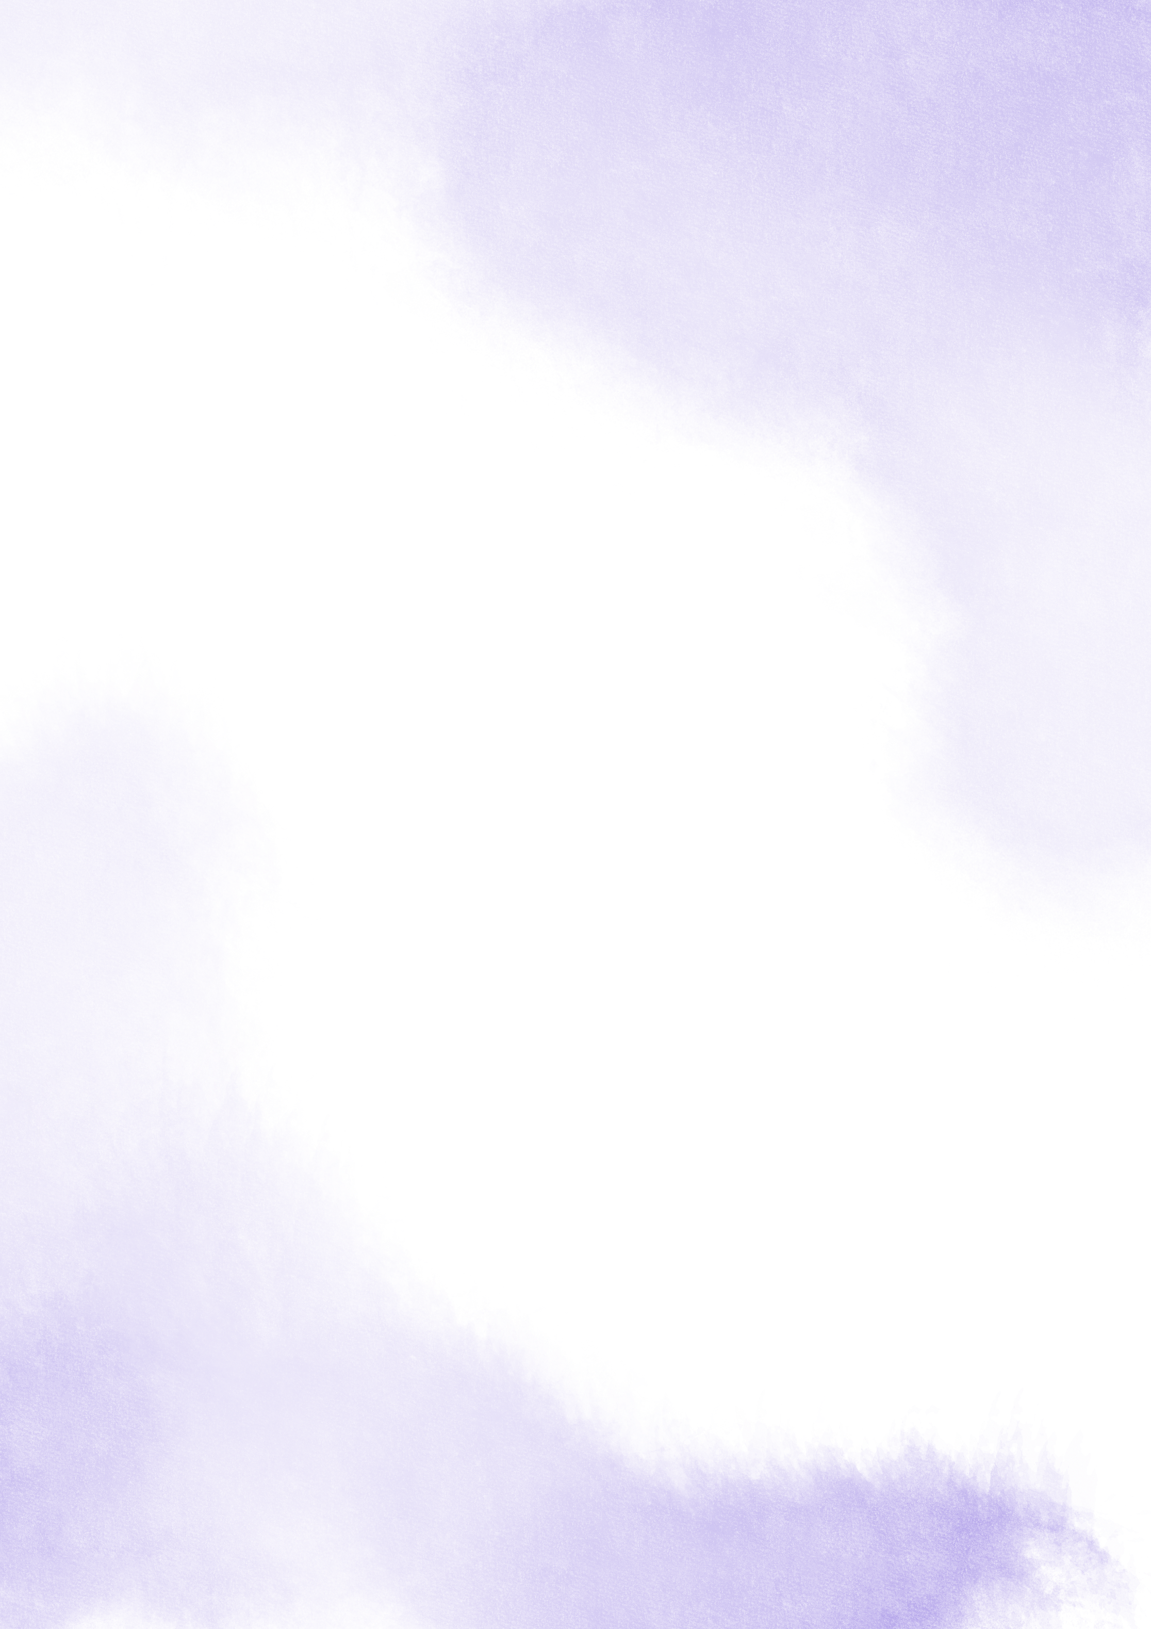



Stations of the Cross
Caritas Diocese of Brentwood and the Brentwood Catholic Youth Service invite you to celebrate the Way of the Cross.
This text is from the official celebrations of World Youth Day Lisbon 2023, it is a youthful and contemporary approach
to the Stations, with each of them focused on a specific fragility of young people from across the globe.

Slide 2
Jesus, Remember Me
Jesus, remember me
when you come into your Kingdom.
Jesus, remember me
when you come into your Kingdom.
https://www.youtube.com/watch?v=bQtsJl1RjC0
Ubi Caritas
Ubi caritas, et amor,
Ubi Caritas, Deus ibi est.
(Where charity and love are, God is there.)
https://www.youtube.com/watch?v=Vvfr_2euIFo

Slide 3
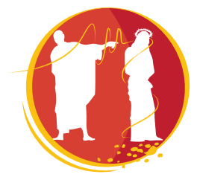


1
JESUS IS CONDEMNED TO DEATH
V. We adore you, O Christ, and we praise you.
R. Because by your holy Cross, you have redeemed the world.
Lord, Pilate signed the decree. He signed the decree that would extinguish Your future.
“This human being must die; his future will be no more ”.
Many of us young people feel this way today, Lord: that our future is being taken from us. We are told that life is full of opportunities, but it’s hard to see where those opportunities are when money is lacking; when you can’t find work and when getting access to education is often impossible.
Lord, even when they condemned You to death, You did not let it get You down. You explained to Pilate that he would have no power over You if God had not allowed it. And, with God by Your side, You pressed on, trusting in the future. Teach us to do the same.
I love you, Jesus, my love above all things and I repent with my whole heart of having offended you. Never permit me to separate myself from you again, Grant that I may love you always, and then do with me what you will.

Slide 4
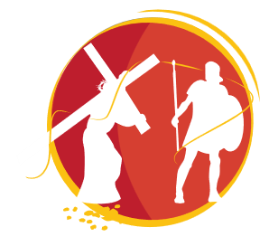
2
JESUS TAKES UP HIS CROSS
V. We adore you, O Christ, and we praise you.
R. Because by your holy Cross, you have redeemed the world.
A heavy log was placed on Your back. And they had already tortured You.
What violence, Lord! You lived in a violent world and You were a victim of that violence.
The world we live in is perhaps not very different. Wars, attacks, mass shootings but also violence in marriages and relationships, child abuse, bullying, abuse of power and families where the words that are thrown around are worse than stones.
They put a Cross on Your back but You, Lord, did not give up. Where did You find the strength to walk? I imagine You saying to Yourself:
“Love will overcome violence”. Lord, give me the strength to love.
I love you, Jesus, my love above all things and I repent with my whole heart of having offended you. Never permit me to separate myself from you again, Grant that I may love you always, and then do with me what you will.

Slide 5
3
JESUS FALLS FOR THE FIRST TIME
V. We adore you, O Christ, and we praise you.
R. Because by your holy Cross, you have redeemed the world.
I am sorry Lord, I’m not used to seeing my heroes abandoned with their mouths covered with dirt.
Why did You subject Yourself? It’s too much abandonment; too much loneliness. You, alone.
I sometimes feel the same, when I’m looking forward to a message that doesn’t come or a hug that doesn’t materialise. Sometimes I think it’s my fault, that I’m awkward, and that I close myself off; other times, I think I live in a selfish world where everyone thinks only about themselves. I don’t know. All I know is that many young people feel alone. Even when they are surrounded by others.
I look at You lying on the ground. I imagine You lifting Your head and looking at me. I imagine You saying: “I fall so that you might rise up with Me. Come, stand up and move forward. Let’s go together.”
I love you, Jesus, my love above all things and I repent with my whole heart of having offended you. Never permit me to separate myself from you again, Grant that I may love you always, and then do with me what you will.

Slide 6
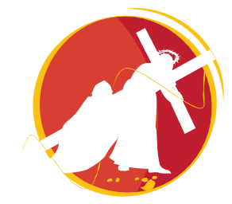
4
JESUS MEETS HIS MOTHER
V. We adore you, O Christ, and we praise you.
R. Because by your holy Cross, you have redeemed the world.
Amid the screams of the crowd, You probably heard Your mother’s voice. A soft and unmistakable voice.
“My son. Here I am”. You sought out her face. In it You found serenity, a head nodding “yes”. “Yes”.
That was all You needed to see. Confirmation. A sign rooted in pure love. As if to say: “Go forward, commit Yourself, commit Yourself to Good. God will help.”
Whisper in my ear, mother of Jesus. Speak to me about love, about commitment. Commitment to Good. Don’t let me sit around and wait. Waiting for the “perfect moment”, the perfect person, the perfect job, the perfect Church. Don’t let me sit and wonder while the world goes on without me and without all I have to offer. Mary, help me to embrace my vocation.
I love you, Jesus, my love above all things and I repent with my whole heart of having offended you. Never permit me to separate myself from you again, Grant that I may love you always, and then do with me what you will.

Slide 7
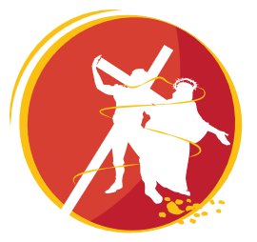
5
SIMON OF CYRENE HELPS JESUS
TO CARRY HIS CROSS
V. We adore you, O Christ, and we praise you.
R. Because by your holy Cross, you have redeemed the world.
The soldiers forced a man named Simon to carry Jesus’ Cross. They didn’t ask him, they forced him. Under duress.
He was a countryman. Not even a Roman. He was worthless, he had no right, no say in the matter.
The world today is also full of exclusion and intolerance. There are minorities that have no right to speak or even to exist. In many countries, you can’t even practice the religion of your choice. There are many people who cannot freely express their ideas. Each group wants to impose its own point of view and shun anyone who thinks differently. Sometimes even within the Church. Sometimes even within our hearts.
You, Lord, were victim of intolerance. But You didn’t let Yourself be overcome by hate. And that’s why You can be a bridge between everyone. Teach us to be bridge builders wherever we are.
I love you, Jesus, my love above all things and I repent with my whole heart of having offended you. Never permit me to separate myself from you again, Grant that I may love you always, and then do with me what you will.

Slide 8
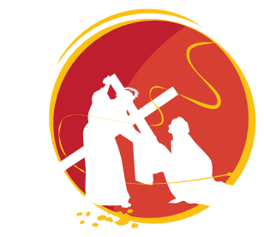
6
VERONICA WIPES THE FACE OF JESUS
V. We adore you, O Christ, and we praise you.
R. Because by your holy Cross, you have redeemed the world.
Lord, a woman broke through the crowd to wipe Your face and had Your image engraved on her veil.
That’s what love is, it’s letting yourself be moved by the other’s face, even when it is disfigured.
The face of a beloved child, a beloved friend, a beloved poor person, a beloved wife or husband. The face of the Church that is beloved, even when disfigured.
To love is to let yourself be attracted to the face of the other. But we young people live in an individualistic world. We were told a thousand times that what mattered most was our image and our self-realisation. That we had the right to be happy and that we should think of ourselves first. And here we are, self-centred, each one focused on our phone, on our own affairs, on our island, waiting for a happiness that never comes. Because true happiness lies in letting yourself be attracted to the other’s face.
I love you, Jesus, my love above all things and I repent with my whole heart of having offended you. Never permit me to separate myself from you again, Grant that I may love you always, and then do with me what you will.

Slide 9
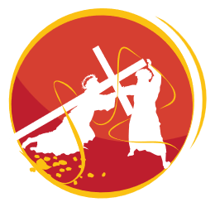
7
VERONICA WIPES THE FACE OF JESUS
V. We adore you, O Christ, and we praise you.
R. Because by your holy Cross, you have redeemed the world.
Lord, a woman broke through the crowd to wipe Your face and had Your image engraved on her veil.
That’s what love is, it’s letting yourself be moved by the other’s face, even when it is disfigured.
The face of a beloved child, a beloved friend, a beloved poor person, a beloved wife or husband. The face of the Church that is beloved, even when disfigured.
To love is to let yourself be attracted to the face of the other. But we young people live in an individualistic world. We were told a thousand times that what mattered most was our image and our self-realisation. That we had the right to be happy and that we should think of ourselves first. And here we are, self-centred, each one focused on our phone, on our own affairs, on our island, waiting for a happiness that never comes. Because true happiness lies in letting yourself be attracted to the other’s face.
I love you, Jesus, my love above all things and I repent with my whole heart of having offended you. Never permit me to separate myself from you again, Grant that I may love you always, and then do with me what you will.

Slide 10
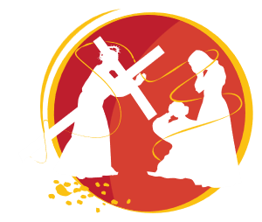
8
JESUS MEETS THE WOMEN
OF JERUSALEM
V. We adore you, O Christ, and we praise you.
R. Because by your holy Cross, you have redeemed the world.
On the way, Lord, You came across women who wept for You. “Do not weep for Me”.
You told them “weep instead for yourselves and for your children”. You didn’t want easy tears that change nothing.
You wanted them to think about themselves and the world they would leave for the next generation, for the future.
We too ask ourselves what our future on this planet will be like. We witness the unchecked consumption of the earth’s resources, the extinction of species, and the devastation of forests. We are frightened by climate change and feel very insecure about the future. And all of this is linked to disordered lifestyles that cause some to starve while others get sick from overeating.
Lord, teach us to lead lifestyles of simplicity and solidarity, to be more aware of the consequences of our actions, closer to what is essential. More like You.
I love you, Jesus, my love above all things and I repent with my whole heart of having offended you. Never permit me to separate myself from you again, Grant that I may love you always, and then do with me what you will.

Slide 11
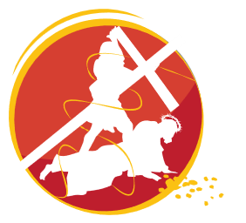
9
JESUS FALLS FOR THE THIRD TIME
V. We adore you, O Christ, and we praise you.
R. Because by your holy Cross, you have redeemed the world.
A third time on the ground, Lord? I fear for You, I am afraid that You will not be able to get up.
Or that You might fall again, as soon as You get back on Your feet.
Maybe You want to draw close to those young people who fall down again every time they try to get up. They accuse them of being weak, and of not resisting drugs, pornography, and alcohol. They accuse them of taking refuge in their screens, to the point of becoming addicted. They just don’t understand that getting up might require strength they no longer have. And a faith they’ve already lost.
I look at You lying on the ground. I imagine You saying to every young person with an addiction: “I fall so that you might rise up with Me. Go, seek help, stand up, and move forward. With me, this time, you’ll make it. Let’s go together.”
I love you, Jesus, my love above all things and I repent with my whole heart of having offended you. Never permit me to separate myself from you again, Grant that I may love you always, and then do with me what you will.

Slide 12
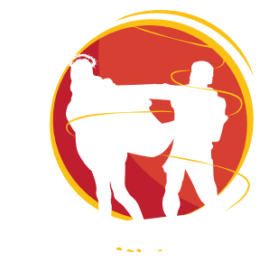
10
JESUS IS STRIPPED OF HIS CLOTHES
V. We adore you, O Christ, and we praise you.
R. Because by your holy Cross, you have redeemed the world.
They stripped You, Lord, they removed Your clothes. I look at You, serene and confident in Your naked truth.
Despite being naked, You remain who You are because You never built an image of Yourself.
You, in Your humility and in Your integrity. In Your truth.
But we live in a world of mirrors where all that matter is our appearance, our image. Selfies after selfies. The tyranny of the right body and the perfect smile. Photos of us on social media in carefully studied poses. Artificial posts waiting for likes. A terrible feeling of not being allowed to be ourselves, of having to sell ourselves so that people appreciate us and we are not left isolated. Narcissism that, in the end, leaves us alone on distant islands.
But You stand naked, just Yourself, unashamed of who You are. You lived not for Your image but for Good. Teach me, Lord. Give me the strength to be different, not to be a slave to my image, but to live according to my conscience.
I love you, Jesus, my love above all things and I repent with my whole heart of having offended you. Never permit me to separate myself from you again, Grant that I may love you always, and then do with me what you will.

Slide 13
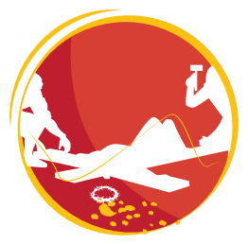

11
JESUS IS NAILED TO THE CROSS
V. We adore you, O Christ, and we praise you.
R. Because by your holy Cross, you have redeemed the world.
A nail in each wrist, a third in Your feet. Just like that, You were stuck.
Still, they shouted to You from below: “Are You not the Son of God? Come down from the Cross!”
But the Cross wasn’t a situation You just happened to be in; it was the inevitable consequence of not giving up on loving us until the end.
A clash between love and the violence of the world.
Nowadays, many people desperately try to escape from inhumane situations. They flee war, hunger, lack of water and political persecution. Their home ceased to be their shelter and became the likely place of their death. They seek refuge in some other place in the world, which one day they might call “home”.
Stuck to the cross, Lord, give courage to all the young people who have to flee so as not to lose their lives.
And to those who live comfortably in their home, give a heart similar to Yours.
I love you, Jesus, my love above all things and I repent with my whole heart of having offended you. Never permit me to separate myself from you again, Grant that I may love you always, and then do with me what you will.

Slide 14

12
JESUS DIES ON THE CROSS
V. We adore you, O Christ, and we praise you.
R. Because by your holy Cross, you have redeemed the world.
“Father, into Your hands I commend My spirit”. You abandoned Yourself into the arms of the Father.
You breathed your last and You died. And with You went all the words You didn’t get to say, all the embraces
You didn’t get to give, all the healing You didn’t get to do.
It seems like a waste, Lord! How much good could You have done with a few more decades of life? And yet Your words were “It is finished”. There was nothing left to accomplish. Because there, on the Cross, You left us everything we needed so we can be saved: pure love, even though it is powerless and apparently useless.
Nowadays, only the productive matter. The elderly don’t count, people with disabilities don’t count, the unemployed don’t count, and the dreamers don’t count. Nor do the games of children, so often forced to work to earn money, or to study more and more, so that one day they might be “true winners” in the job market. However, it is love that saves. Hide me in Your loving wounds, Lord!
I love you, Jesus, my love above all things and I repent with my whole heart of having offended you. Never permit me to separate myself from you again, Grant that I may love you always, and then do with me what you will.

Slide 15
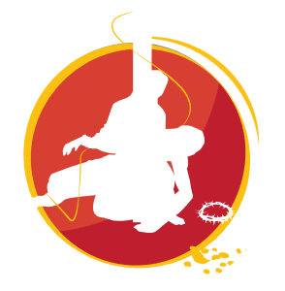
13
JESUS IS TAKEN DOWN FROM THE
CROSS AND GIVEN TO HIS MOTHER
V. We adore you, O Christ, and we praise you.
R. Because by your holy Cross, you have redeemed the world.
Pietá. Jesus in the arms of Mary. A son on his mother’s lap. The purest truth of selfless love. The Word resting in silence.
And we remain lost in a world saturated with hasty words, information, news, publicity, and interests, in which we no longer distinguish between truth and lies, nor do we know who to believe!
Lord, I don’t have to know everything, I don’t want to know everything. I just want to know what is necessary in order to be a better person and create a more humane world. Give me a great love for everything in the world that is pure, true, simple and human.
I love you, Jesus, my love above all things and I repent with my whole heart of having offended you. Never permit me to separate myself from you again, Grant that I may love you always, and then do with me what you will.

Slide 16
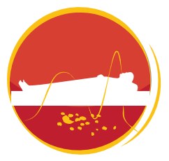
14
JESUS IS LAID IN THE TOMB
V. We adore you, O Christ, and we praise you.
R. Because by your holy Cross, you have redeemed the world.
The cemetery. The end. When the stone covered the entrance to the tomb it seemed that everything was definitely over.
It seemed, Lord, that You and Your way of love had been nothing but an illusion.
A deceptive hope in a hypothetical triumph of good over evil. It seemed that everything was over, that we had to be realistic, that the world was really for the clever and not for those who dream of Good, like You.
So often in our lives there seems to be no future. We can’t see the light at the end of the tunnel. We are afraid to look ahead. We can’t make decisions, we don’t see how the story can go on, all we see are large boulders blocking the path in front of us.
I love you, Jesus, my love above all things and I repent with my whole heart of having offended you. Never permit me to separate myself from you again, Grant that I may love you always, and then do with me what you will.

Slide 17


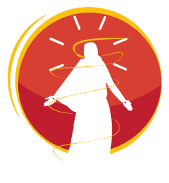
This is where we need to hear Mary’s voice.
Telling us of ends that are beginnings, the apparent death of a tree in winter when it is just getting ready to flower in spring.
Of tombs which are gateways to resurrection.

